Slide 2
SparkSQL
Like SQL, but less so. ☺ (Meow)
Use magic keyword %%sql in the notebook cell
Spark.sql (“ select * from tbl “)
%%sql a number of limitations – variable handling

Slide 3
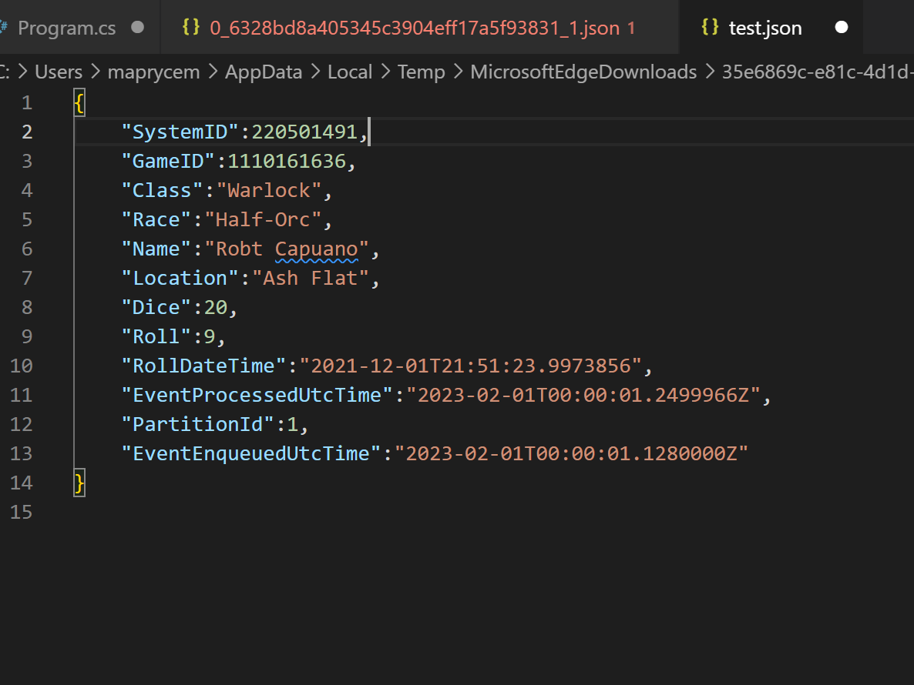
Source Data types
SystemID: Random Number
GameID: ID for each D&D game
Name: The name of player
Class: The class of the character
Race: The race of the character
Dice: The type of dice
Roll: The roll
RollDateTime: When the roll happened
Additional fields added by event hub
EventProcessUTCTime: Time the event was processed
PartitionId: From event hubs
EventEnqueuedUTCTime: Time the event was queued

Slide 4
Source Data types
SystemID: C# random number (changes every message)
GameID: C# random number (changes per game)
Name: Random from list.
Location: Random from a list.
Class: "Barbarian","Bard","Cleric","Druid","Fighter","Monk",
"Paladin","Ranger","Rogue", "Sorcerer","Warlock","Wizard"
Race:"Dragonborn","Dwarf","Elf","Gnome","Half-Elf","Half-Orc","Halfling","Human","Tiefling"
Dice: number of sides: 4, 6, 8, 12, 20
Roll: Is a dice roll
Names and Locations are generated for OpenSource C# library - RandomNameGeneratorLibrary
Lakehouseinaday/Program.cs at main · SQLStijn-MSFT/Lakehouseinaday (github.com)

Slide 5
Things to note
Dice roll includes the players modifier. (i.e. could be larger than the dice)
SystemID and GameId are random numbers, (i.e. may not be unique)
The player may change their race and class between games

Slide 6
Synapse SparkSQL – Bronze hints
Execute notebook with parameters from Pipelines using parameters. Azure Synapse Notebooks – Passing Parameter and Return or Capture Output – aboutdataai.com.au
You can’t use parameters in the SQL
Use spark.sql(“select * from table where col = {0}”.format(variable))
Allow scripts to be executed many times
CREATE DATABASE IF NOT EXISTS
CREATE TABLE IF NOT EXISTS
DROP TABLE IF EXISTS

Slide 7
SparkSQL Hints - Silver
Connect to source files using External table..
spark.sql("CREATE TABLE database.name USING JSON LOCATION 'abfss://container@storageaccount.dfs.core.windows.net/folers/{0}/*.json'".format(variable))
Use rlike(column,'[a-zA-Z]’) to put regular expression in where clause
Useful Time functions:
to_date (column)
date_format (column,"HH")
to_timestamp(column)

Slide 8
SparkSQL Hints - Gold
Identity columns don’t exist – be creative.
Maybe use row_number() over
Create dimensions, then create the fact table(s)

